Slide 1





Regression and Linear models
Dexter R. Shepherd
d.r.shepherd@sussex.ac.uk
University of Sussex

Slide 2
Todays session
Introduce the concepts of regression
Moving onto GLMs (or logistic regression)
Talk about open datasets

Slide 3
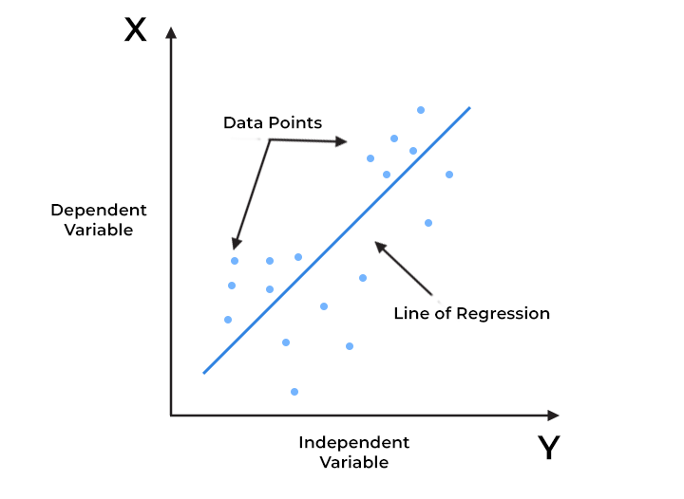
Overview of regression analysis
Regression in simple terms is a statistical method used to understand and quantify the relationship between two or more variables. It helps us predict or estimate the value of one variable based on the values of other variables.

Slide 4
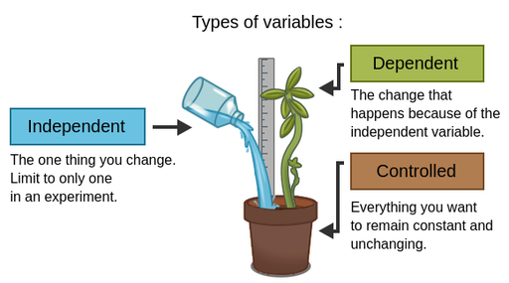
Key terms in regression
Dependent variable – The variable being predicted
Independent variable – The variable used to predict the dependent
Types we will cover:
Linear regression
Multiple linear regression
Logistic regression

Slide 5
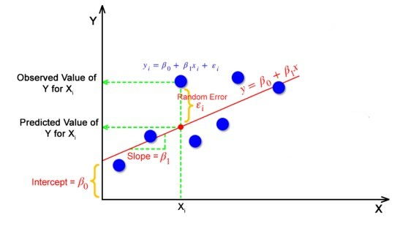
Linear regression
Simplest form of regression
Purpose: Predict and understand the relationship between variables

Slide 6
Example
Predicting salary based on experience
Salary=β0+β1 ×Years of Experience+ϵ
β0 is the intercept (base salary when experience is zero).
β1 is the slope (change in salary for each additional year of experience).
ϵ represents the error term.

Slide 7
Example
Salary (y) | Years experience (x)
10k | 3
11k | 4
15k | 3
20k | 5
30k | 10
50k | 10
60k | 12
61k | 11
70k | 13

Slide 8
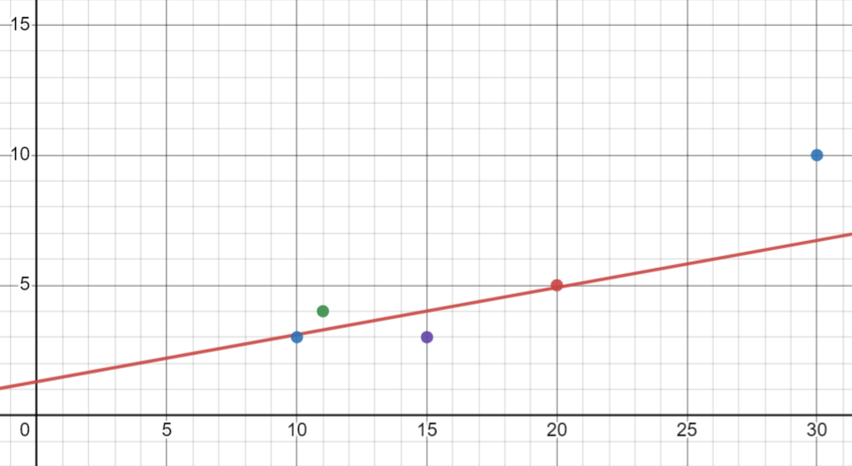
Example
Regression models are trained to fit your data set
Calculate the mean of x and y:
X mean = 36.33…
y mean = 7.88…
Then calculate
β1 = covariance(X,Y)/variance(X) = 0.181…
β0 = y mean - β1 * x mean = 1.290…
Y = β1x + β0
Notes:
Covariance (Cov): Measures how much two variables change together. It is calculated by summing the product of the differences of each variable from its mean:
Variance (Var): Measures how much a variable varies from its mean. It is calculated by summing the squared differences of each value from the mean:

Slide 9
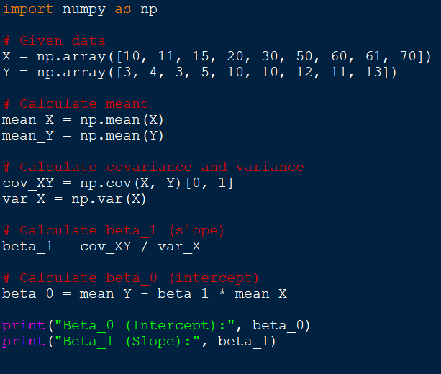
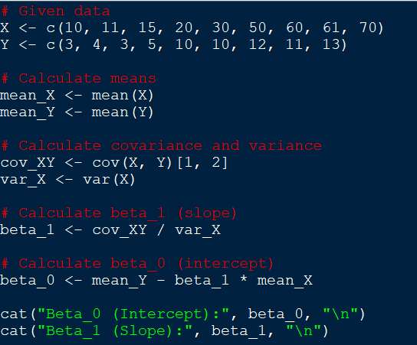
Coding this

Slide 10
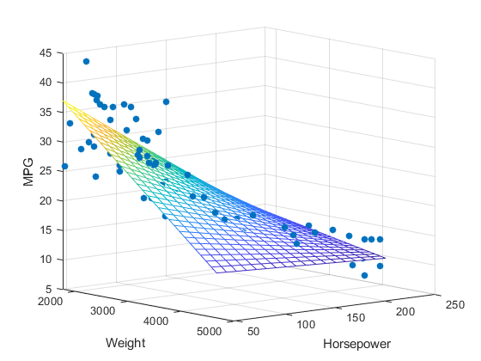
Multi-linear regression
A linear regression model with more than one independent variable
An example of this could be how the number of bedrooms, square footage, and distance to schools can influence the cost of a house

Slide 11
Adapting the formula
Change in formula
Y=β0+β1 × X0 + β2 × X1 + … + βn × Xn + ϵ

Slide 12
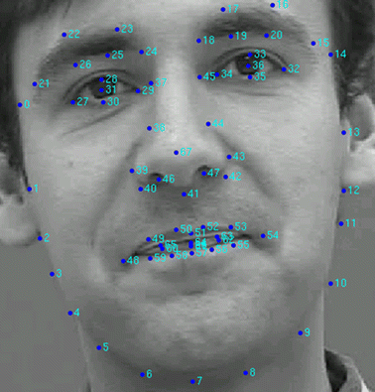
Regression for images
Images are much more complex than the variables we used as examples.
We have a data set of images and label data of coordinates for facial features
Deep learning and NN can be used
Regression is sometimes more efficient

Slide 13
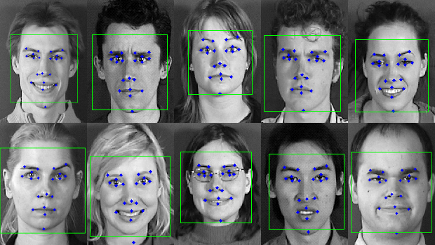
Assumptions
All images are the same size (n,m)
Same number of labels for every image

Slide 14
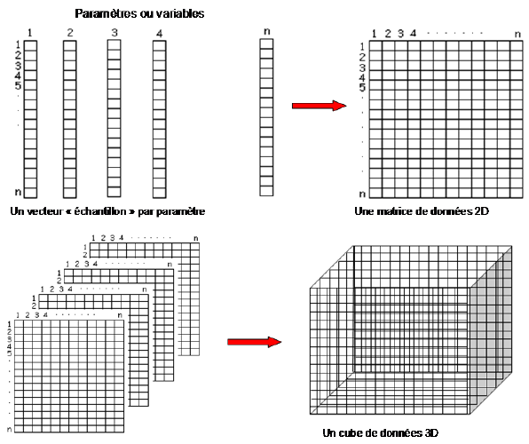
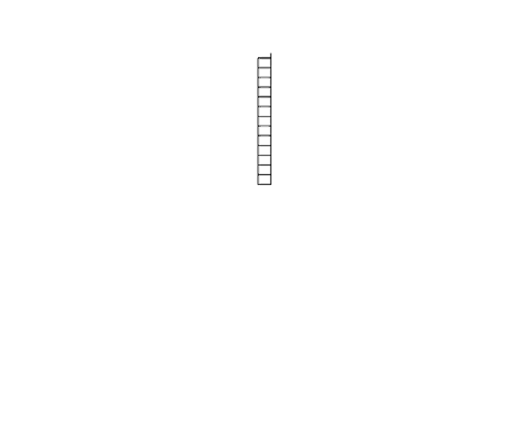
Image to linear data
X data:
2D image (n,m) to 1D input layer (n*m)
Y data:
List of coordinates from 2D to 1D

Slide 15
Generalised Linear Regression
Lets say you want to predict spike counts based on stimuli
Linear regression can indeed have negative terms, and negative spike counts do not exist…
Spike counts are discrete and non negative. How can we enforce this in our model?

Slide 16
Generalised Linear Regression
Linear regression is essentially y=mx+c
Generalised regression takes into consideration a function that can enforce the bounds of the task. Y=f(mx+c)
f can be referred to as the link function, for classification this could be sigmoid.

Slide 17
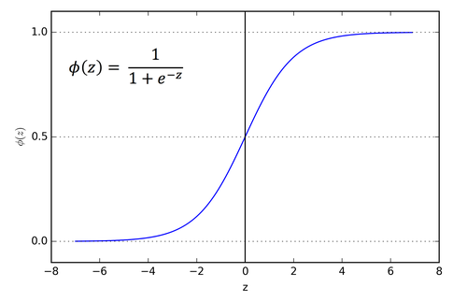
Logistic regression
There are many important research topics for which the dependent variable is "limited."
For example: voting, mortality, or number of accidents is not continuous or distributed normally.
Z = X⋅W = w1​⋅x1​+w2​⋅x2​+…+wn​⋅xn
Uses the sigmoid function to enforce the classification
You can also have a bias term
Number of weights = number of features + one bias

Slide 18
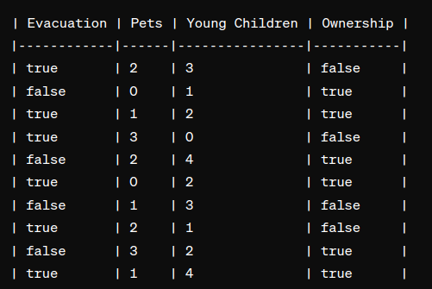
Example
There is a flood!
Based on characteristics can we predict who is not likely to evacuate so search and rescue teams can find them.
True and false will be represented as 1 or 0 for numeric compliance with the module
Evacuation is our y
The rest is our x

Slide 19
Randomly create our model
z=w⋅X+b
Y_hat = sigmoid(Z)
Let’s say all weights are = 0.1
Bias = 0.1

Slide 20
Randomly create our model
z=w⋅X+b
Y_hat = sigmoid(Z)
Let’s say all weights are = 0.1
Bias = 0.2
Item one: 2*0.1 + 3*0.1 + 1*0.1 + 0.2
= 0.8
Sigmoid activation = 1
Correct?

Slide 21
Randomly create our model
z=w⋅X+b
Y_hat = sigmoid(Z)
Let’s say all weights are = 0.1
Bias = 0.2
Item one: 0*0.1 + 1*0.1 + 1*0.1 + 0.2
= 0.4
Sigmoid activation = 1
Correct?

Slide 22
Training
Initialization: Initialize the weights (coefficients) and the bias term. ✅
Calculate the Predictions: Use the current weights to make predictions.✅
Calculate the Cost Function: Compute the cost function (log loss) based on the predictions.
Calculate Gradients: Compute the gradients of the cost function with respect to each weight.
Update Weights: Update the weights using the gradients and the learning rate.
Repeat: Repeat steps 2-5 until convergence (or for a fixed number of iterations).

Slide 23
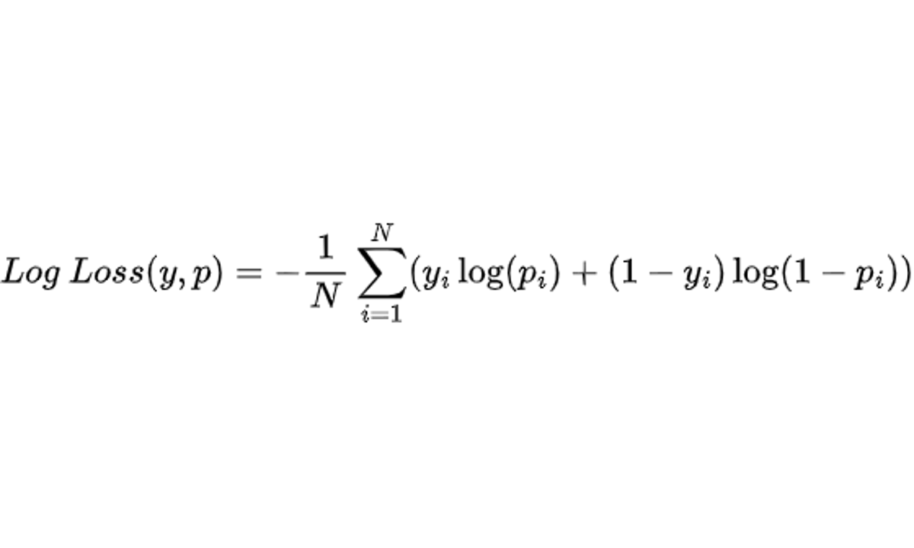
Log loss
Y is our values and p is our predicted
The log loss function penalises confident and incorrect predictions more heavily than uncertain ones.
It is commonly used as the evaluation metric for binary classification problems, especially when dealing with imbalanced datasets or when probabilistic interpretations of the predictions are important.
Notes:
ylog(p) = his term penalizes the model when the actual label (y) is 1 and the predicted probability (p) is close to 0. The logarithm ensures that this penalty increases as the predicted probability approaches 0. When y is 0, this term becomes 0 regardless of the predicted probability.
(1-y)log(1-p) = This term penalizes the model when the actual label (y) is 0 and the predicted probability (p) is close to 1. Similar to the first term, the logarithm ensures that this penalty increases as the predicted probability approaches 1. When y is 1, this term becomes 0 regardless of the predicted probability.
-1/n sum = This term calculates the average over all samples, effectively computing the mean log loss across the entire dataset.

Slide 24

Code does this all for you!
Two lines!

Slide 25
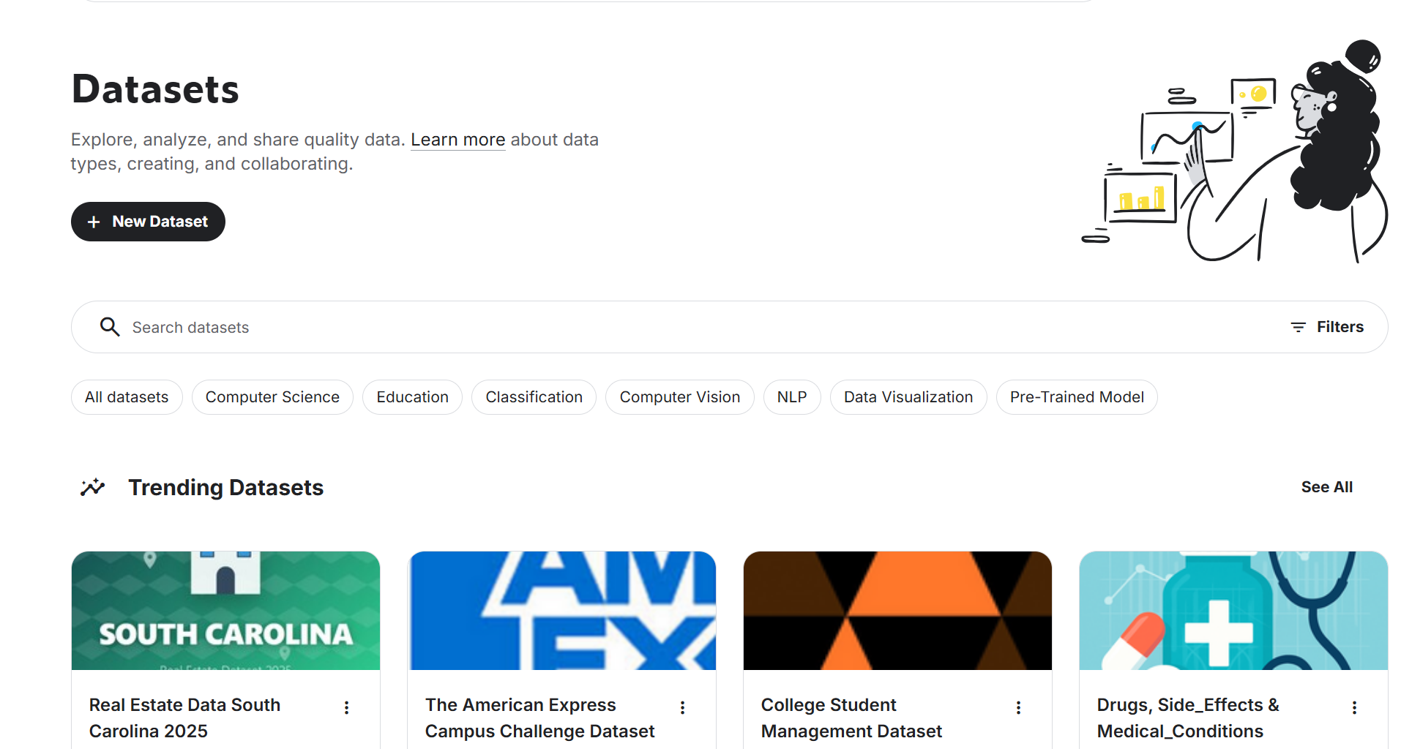
Online datasets
Kaggle is a great resource
But why use open datasets?
Saves you gathering the data
It is free
Submitting your own data benefits all
Watch out for quality though!

Slide 26
Worksheets today
We will download online datasets
We will grab the data we want from the dataset
We will train regression models and optimise them
Challenge: Once completed can you find your own datasets

